Slide 1
More on loops in C
Department of Computer Science and Engineering,
Chitkara University, Punjab

Slide 2
Nested for loops
Nested for loop:
A nested for loop is a loop inside another loop. It is commonly used in programming when you need to iterate over multiple dimensions, such as rows and columns in a matrix or performing tasks for each combination of elements in two sets.
Need of Nested for loop:
Nested for loops are highly useful in various programming scenarios, especially when dealing with multidimensional or hierarchical data. Here are some common uses of nested for loops:
Working with 2D Arrays or Matrices
Used to iterate through rows and columns of a 2D array or matrix.
2. Generating Patterns
Useful for creating patterns like triangles, pyramids, or grids.
3. Cartesian Product
Finds all possible combinations of elements from two or more lists.

Slide 3
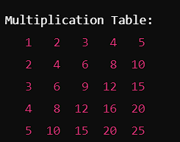
Example
Generating a Multiplication Table:
CODE:
#include <stdio.h>
int main() {
int rows, cols;
// Input for the number of rows and columns
printf("Enter the number of rows: ");
scanf("%d", &rows);
printf("Enter the number of columns: ");
scanf("%d", &cols);
OUTPUT:
// Nested loop for multiplication table
printf("\nMultiplication Table:\n");
for (int i = 1; i <= rows; i++) {
for (int j = 1; j <= cols; j++) {
printf("%4d", i * j); // Print product with formatting
}
printf("\n"); // New line after each row
}
return 0;
}

Slide 4
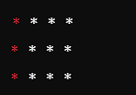
Pattern printing with loops
PRINTING A PATTERN A 2D GRID:
CODE:
#include <stdio.h>
int main() {
int rows, cols;
// Input for the number of rows and columns
printf("Enter the number of rows: ");
scanf("%d", &rows);
printf("Enter the number of columns: ");
scanf("%d", &cols);
OUTPUT:
OUTPUT:
// Printing the 2D grid
printf("\n2D Grid:\n");
for (int i = 0; i < rows; i++) {
for (int j = 0; j < cols; j++) {
printf(“* "); // Printing each cell
}
printf("\n"); // New line after each row
}
return 0;
}

Slide 5
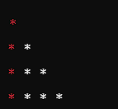
Pattern printing with loops
TRIANGLE PATTEN OF *:
CODE:
#include <stdio.h>
int main() {
int rows;
// Input for the number of rows
printf("Enter the number of rows for the triangle: ");
scanf("%d", &rows);
OUTPUT:
// Printing the triangle pattern
for (int i = 1; i <= rows; i++) {
for (int j = 1; j <= i; j++) {
printf("*"); // Print an asterisk
}
printf("\n"); // New line after each row
}
return 0;
}

Slide 6
DO WHILE LOOP
DO WHILE LOOP:
A do-while loop is a control flow statement that allows code to be executed repeatedly based on a given boolean condition. Unlike a standard while loop, a do-while loop guarantees that the code block inside the loop is executed at least once, regardless of whether the condition is initially True or False.
SYNTAX:
do {
// Code block to execute
} while (condition);

Slide 7
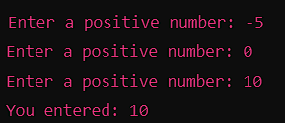
EXAMPLE
CODE:
#include <stdio.h>
int main() {
int number;
do {
printf("Enter a positive number: ");
scanf("%d", &number);
} while (number <= 0);
printf("You entered: %d\n", number);
return 0;
}
OUTPUT:

Slide 8
Practice Questions
1. WAP to display multiplication table from 1 to 10.
2. WAP to find factorial of 1st 10 numbers.
3. Print Prime number in a given range
4. Find composite numbers between 2 to 1000
5. WAP to find input number is Armstrong or not.
6. Write a C program that calculates the sum of even and odd numbers from 1 to 50 using do-while loops.
7. Wap to print the pattern of square star pattern.
***
***
***

Slide 9
Thank
You!

